Slide 1
Background Slides For Defense

Slide 2
Datasets
Anomaly Injection: model is expected to detect the injected data points as outlier.
Anomaly Injection in real world datasets:
In Soccer dataset there are players with different positions; we consider players of a specific position as normal population and inject players of a different position as outliers.
Strikers as normal; Goalies as outlier
Midfielders as normal; Strikers as outlier
In IMDb dataset, there movies with different genres; we consider movies of a specific genre as normal population and inject movies of different genre as outliers.
Drama vs. Comedy

Slide 3
Feature Function
A function that aggregates the multiple instantiations to derive a real number that is the value of the attribute.
We can use either term frequency (TF) or term frequency/inverse document frequency (TF-IDF).
We call TF and TF-IDF that map multiple instances of a formula to real values: Feature Functions

Slide 4
Outlier Detection Challenges
How to model “normality”?
Choosing distance or similarity measure
Noise vs. Outlier
Interpretability
Class Imbalance
Outlier Analysis, Aggarwal, 2013

Slide 6
Evaluation Metrics
Dimensionality: The number of attributes in the final attribute table
Attribute Complexity: The length of conjunctions that define attributes
Outlier Analysis Run Time
Attribute Construction Time
Apply state-of-the-art outlier detection methods to the attribute table in order to compare the performance of different feature generation methods.
Performance accuracy score: AUC

Slide 7
Categorization of Existing outlier Detection work
Outlier Detection in Static Data
Outlier Detection in Dynamic Data
Out of Scope of this Work
Input Format:
Propositional Data
Input Format:
Structured Data
Community Discovery
Association Rules
Generative Model Based
Density-based
Distance-based
Subspace Clustering
Generative Model-based

Slide 8
Real world Data
IMDb
Drama vs Comedy
Premier League
Striker vs Goalie
Midfielder vs Striker
PlayerID | MatchID | ShotEff(P,M) | PassEff(P,M) | TackleEff(P,M)
Midfielader | 1 | Low | High | Low
Midfielder | 2 | Low | Low | High
Inject object From Another Class
PlayerID | MatchID | ShotEff(P,M) | PassEff(P,M) | TackleEff(P,M)
Strikers | 1 | Low | High | Low
Strikers | 2 | Low | Low | High
Strikers | 3 | High | High | High
Strikers | 1 | Low | Low | High
Strikers | 2 | Low | High | Low

Slide 9
Alternative Way to Construct Feature
1
Wordification: Using the concept of n-grams from NLP:
Unigram: All single literals.
Bigram: All conjunctions of two literals.
TreeLiker, WARMAR and basically any Propositionalization approach
1 Wordification Approach to Relational Data Mining, Perovsek et. Al, 2013

Slide 10
Previous Propositional Outlier Detection Method
1
KNN: Distance-based method
It assigns a score to each data point on the basis of distance of the point from its k nearest neighbor
LOF: Density-based method
It quantify the outlierness of the data points relative to regions of different densities.
OutRank: Subspace-based method
It compares clusters in different subspace to derive an outlier score for each object
2
3
1 Efficient Algorithms for Mining Outliers from Large Data Sets, Ramaswamy et al., 2000
2 Outlier Ranking via Subspace Analysis in Multiple views of Data, Muller et al., 2012
3 LOF: Identifying Density-based Local Outliers, Breunig et al., 2000

Slide 11
Model-based Outlier Detection: Loglikelihood distance
How different is an individual from a reference population.
How different is “Brave Hearth” from a random movie?
Define Outlierness metric based on comparing an individual to a random individual

Slide 12
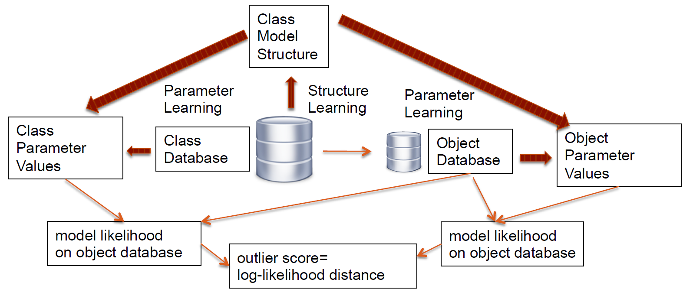
Summary of Approach
Notes:
A class-model Bayes net (BN) structure is learned with data for the entire population.
The nodes in the BN represent attributes for links, of multiple types and attributes of entities, also of multiple types. Given a set of parameter values and an input database, it is possible to compute a class model likelihood that quanties how well the BN ts the object data. The class model likelihood estimates
BN parameter values from the entire population data. This is a relational extension of the standard log-likelihood method for i.i.d. data uses the likelihood
of a datapoint as its outlier score. While the class model likelihood is a good baseline score, it can be improved by comparing it to the object model like-
lihood, which estimates BN parameter values from the object data. The model log-likelihood ratio (LR) is the log-ratio of the object model likelihood to the
class model likelihood. This ratio quanties how the probabilistic associations that hold in the general population deviate from the associations in the object
data substructure. While the likelihood ratio discriminates relational outliers better than the standard log-likelihood, it can be improved further for outlier
detection by applying two transformations: (1) a mutual information decomposition, and (2) replacing log-likelihood dierences by log-likelihood distances.
We refer to the resulting score as the log-likelihood distance.
In terms of the conditional probability
parameters, it measures how much the log-conditional
probabilities in the class distribution differ from those in
the object distribution.

Slide 13
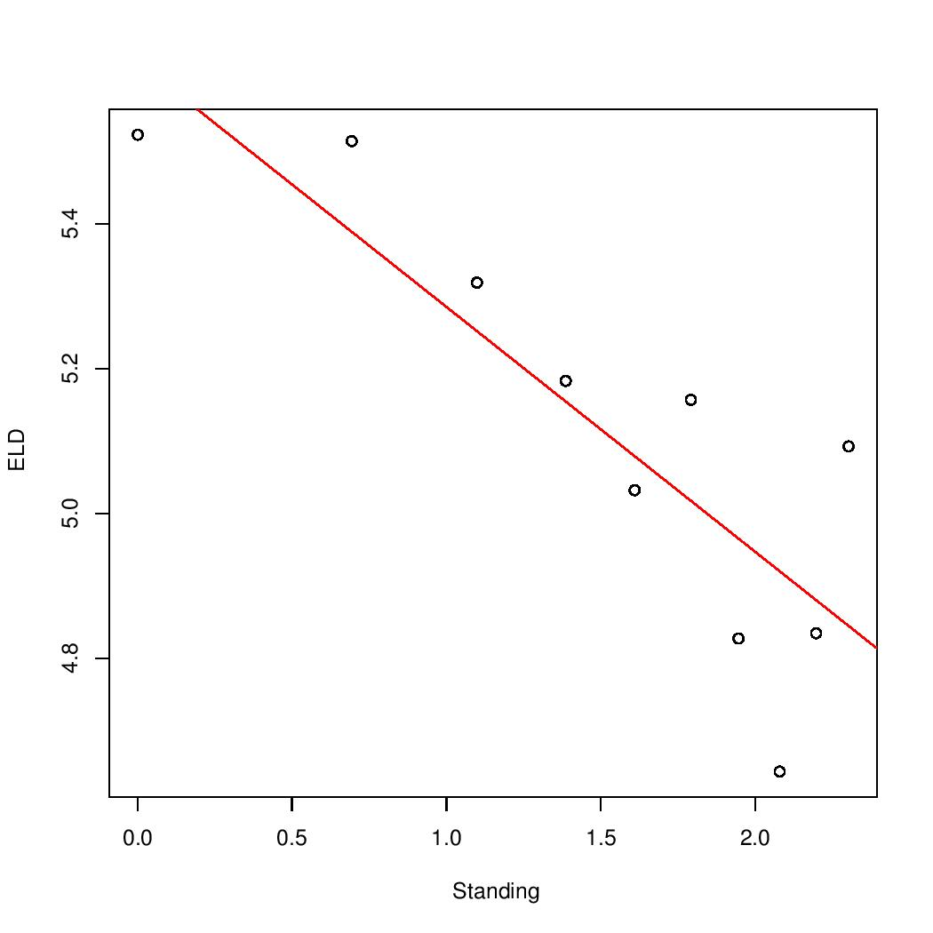
Log-Log Plot Power Law and Goodness of Fit
Pvalue of goodness of Fit test= 0

Slide 14
Noise vs Outlier
The significantly interesting deviation are of interest
Anomalies need to be unusual in an interesting way
A
A
a)
b)

Slide 15
Contextual outlier or linkage outliers when data points have some sort of relationship
Generative models: incorrect choice of data model leads to poor detection; poor fit results in erroneous assumptions
High dimensional data => definition of spatial locality is ill-defined because of data sparsity

Slide 16
A data point is an outlier because of relative position not its extreme position.
Z-value test would failed miserably in figure 1.a as data point A would be as center
Good understanding of data before modeling

Slide 17
Extreme value Analysis
Statistical tails of the underlying distribution
Hawkings define outliers by their generative probability rather than extremity
Based on Hawkings definition {1,2,2,50,98,98,90} the value 50 is the strongest outlier while 50 is the average of dataset and is most definitely not an extreme value

Slide 18
Probabilistic and Statistic Models
Data modeled in the form of a closed form probability distribution. The parameters of the models is learned. Class membership probability of data points are computed
Disadvantage of probabilistic models is that they try to fit the data to a particular kind of distribution which may not often be appropriate for the data

Slide 19
Proximity-based models
The main difference between clustering and density based methods is that clustering methods segment the points whereas density based methods segment the space

Slide 20
Information Network or Frequent Pattern mining
Outliers increase the minimum code length required to describe the dataset

Slide 21
Depth-based methods
based on convex hull analysis.

Slide 22
Distance-based methods
A
B

Slide 23
In practice most outliers are defined based of their relative values

Slide 24
Probabilistic modeling
Cannot detect noise and outlier

